Slide 1
Case Study 4: Sentiment analysis on Marvel Movie IMDb reviews
Bashir Gulistani
Isha Jain
Rohan Rana
Seayar Sroosh
Tanish Kandivlikar

Slide 2
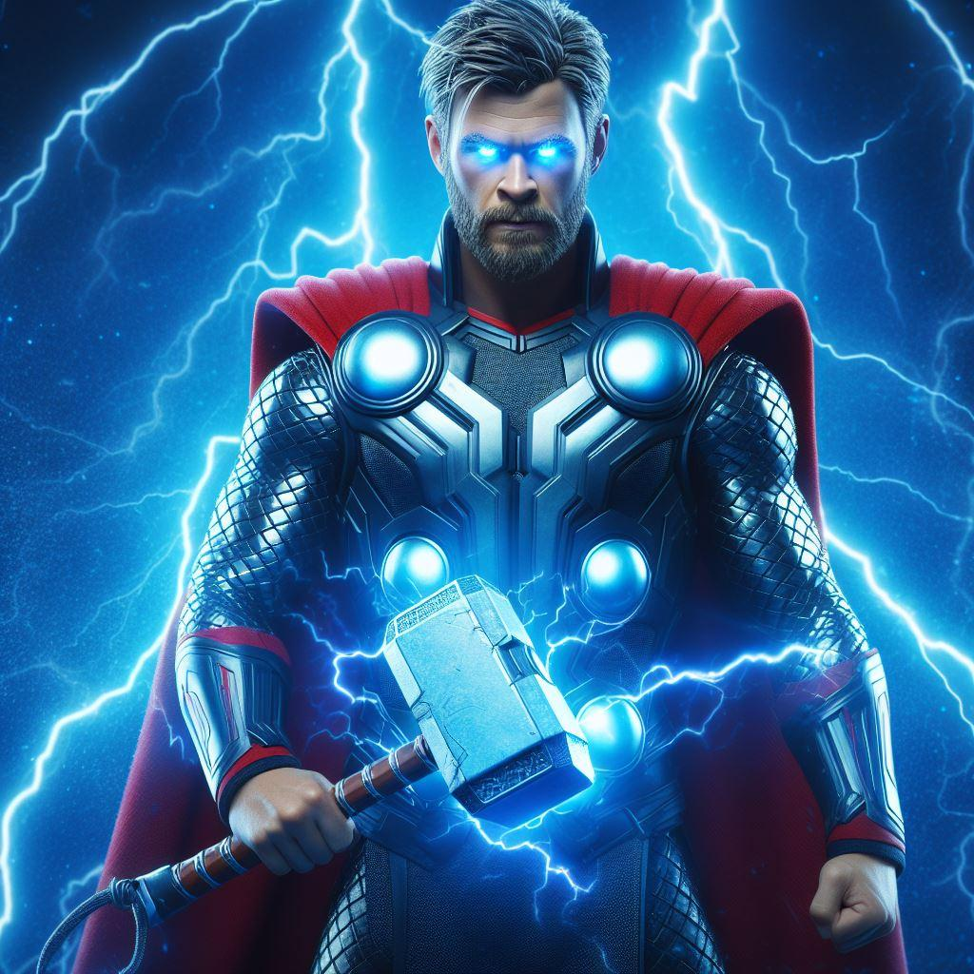
Table of Contents
Business problem
Motivation
Conjectures
Methodology
Results
Reccomendations

Slide 3
Business problem
To figure out how the audience perception has changed in recent years as compared to older movies and series (before 2019).
Marvel can use this analysis to figure out the reasons behind why there is a drop in performance in movie performance recently.
Reasons could be change in audience behavior, novelty effect or a drop in quality of movies produced itself.

Slide 4
Motivation
Since Marvel movies and series aren’t usually standalone but in series, they could benefit from audience recommendations. Improvements could be made based on the same to keep those elements received positively, and doing away with those having not well appreciated.
Much of the Marvel audience is perceived to be quite passionate, following the series with dedication. This can make their reviews to be insightful.

Slide 5
Conjectures
Shift from Audience Preferences: The analysis might reveal that creative direction of disney has shifted away from audience preferences over time.
Impact of Storytelling and Character Development: The qualitative insights from reviews could indicate that the dissatisfaction stems from specific aspects of storytelling or character development in recent MCU movies.
Comparative Success of Individual Titles: Some MCU titles may still perform well, suggesting that the issue is not with the superhero genre as a whole but with certain movies or series.

Slide 6
Methodology
-Data consisting of movie titles, budget, reviews, box office collection (US & Canada and worldwide) was scraped from IMDb for all Marvel movies along with Invincibles (non-Disney show for comparison)
-Rows with missing values were removed
- The Marvel data was divided into 3 sets consisting of:
All movies/series
Movies/series in the first 3 phases (upto 2019)
Movies/seies) in the 4th and 5th phase (post 2019)

Slide 7
Methodology continued
-EDA was carried out. This consisted of rating histograms, box plots for the budget and box office collection and getting the top 20 emojis in reviews by frequency
-The text in the reviews was processed
-Polarities for the processed reviews were plotted
-Sentiment analysis was carried out with the top 20 trigrams as topics

Slide 8
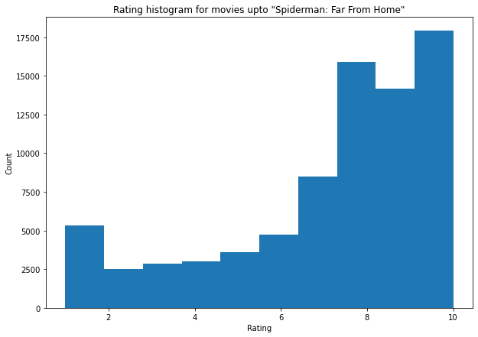
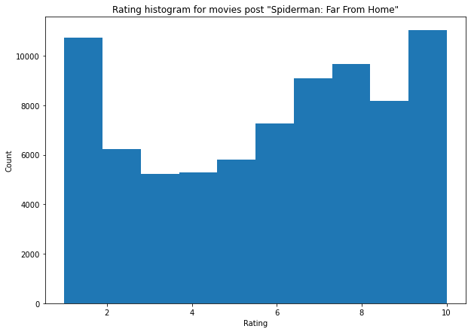
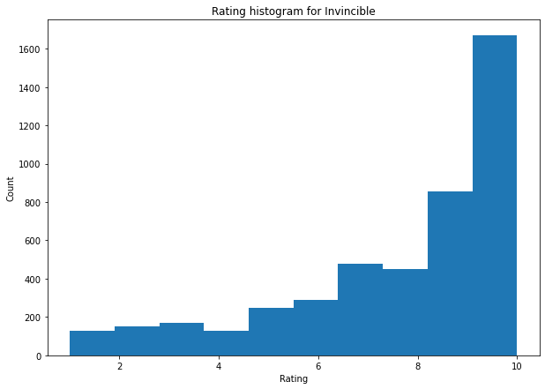
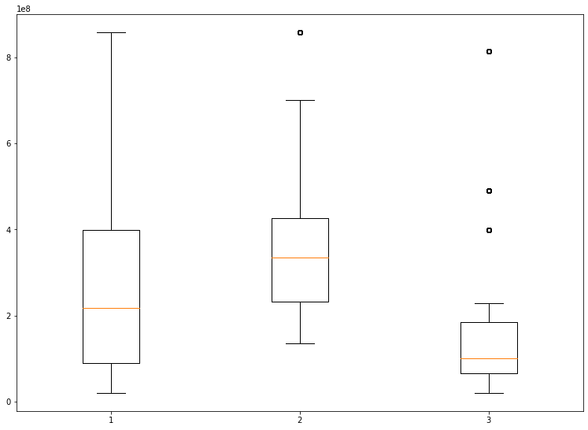
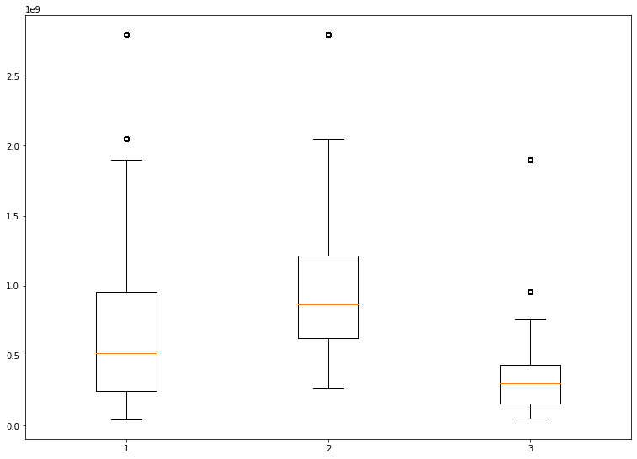
Results
Shift in Audience Preferences:
Box plot of US Canada box office earnings
Box plot of Worldwide box office earnings
Box plot of US Canada box office earnings

Slide 9
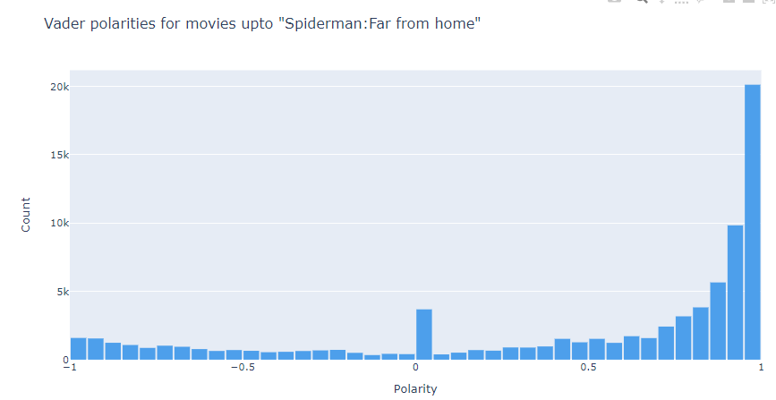
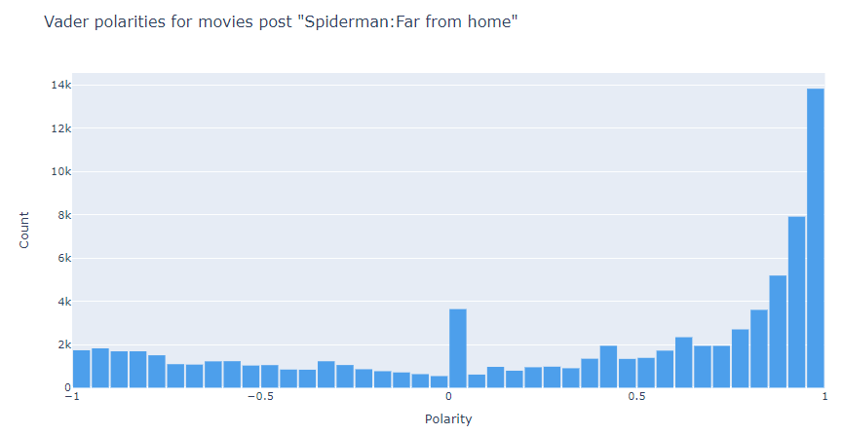
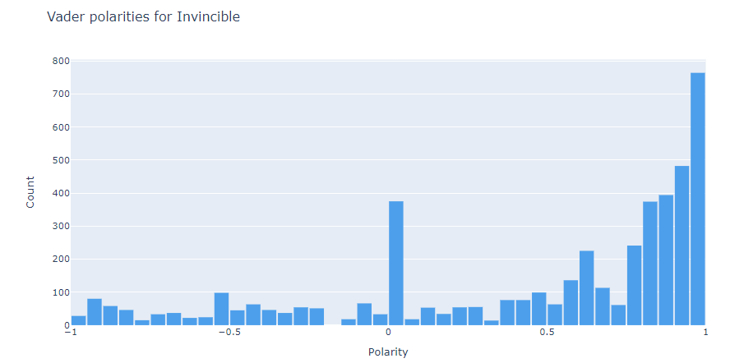
Results continued
Comparison of Vader polarities:

Slide 10
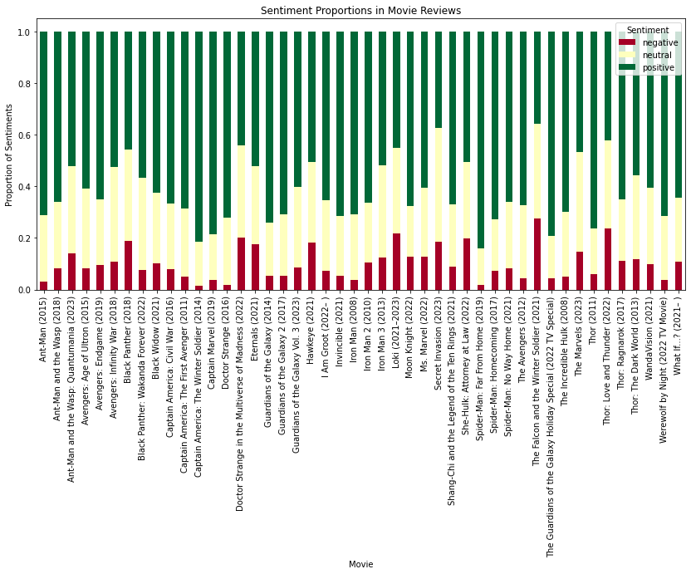
Results continued
Sentiment Analysis to gain insights:

Slide 11
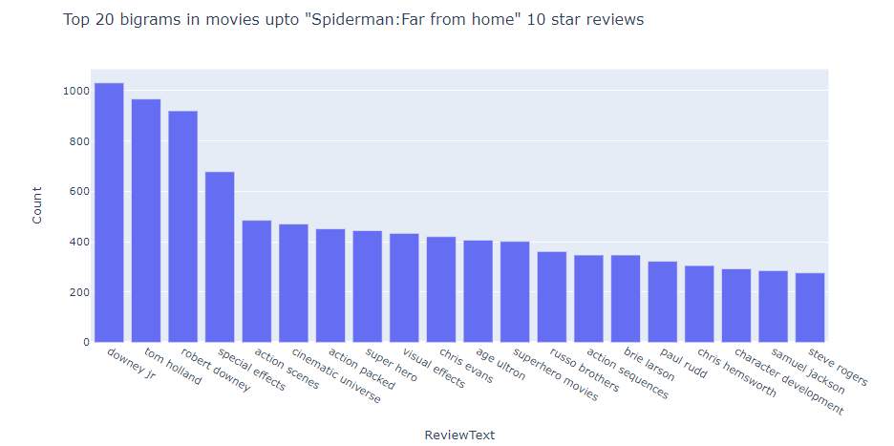
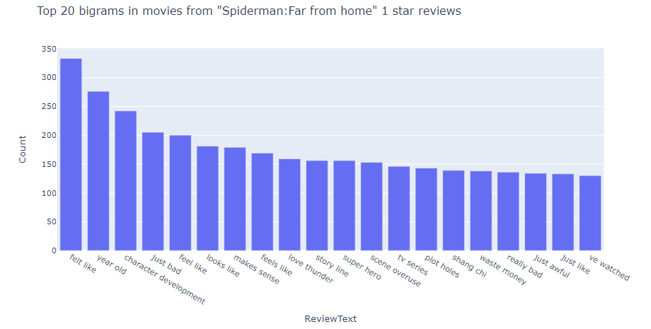
Results continued
Insights:
Positive elements for movies upto ‘Spiderman: Far from Home’ | Negative elements for movies post ‘Spiderman: Far from Home’
-Visual effects -Character development -Action sequences | -Scene overuse -Plotholes -Character development
Notes:
Several bigrams like "special effects" and "character development" suggest that these are focal points in the lowest reviews, indicative of aspects that reviewers often discuss. Terms like "waste money" and "plot holes" imply criticism or negative aspects highlighted by reviewers. The presence of more critical bigrams such as "feels like," "just bad," "really bad," and "bad guys" may indicate that the reviewers are engaging with the content on a critical level, expressing dissatisfaction with certain aspects of the movies. Other bigrams like "action scenes", "cinematic universe", "special effects", "superhero movies", and "character development" suggest that these are key aspects reviewers focus on. The presence of these particular phrases implies that action sequences, the quality of special effects, the overarching cinematic universe, and the depth of character development are significant to the audience's experience.
The mention of "James Gunn" might point towards discussions about the directorial style or the specific movies directed by him. Similarly, "Russo brothers" refers to the directors known for their work on several Marvel movies, which could indicate the reviews are analyzing or commenting on their directorial contributions.

Slide 12
Recommendations
The reviews contain a lot of terms related to action scenes and special effects in both positive and negative reviews meaning that it is something that matters a lot to the audience. Hence, it is important for Marvel to keep developing its special effects and action sequences going forward.
Some complaints the audience had such as plotholes and character development lie with the creative decisions which should be kept in mind by the writers
Scene overuse was another common complaint, this could be addressed by getting more liberal trying new approaches
Marvel could also try to keep involving the most loved stars in their movies such as Robert Downey Jr. and Tom Holland as there were a lot of positive sentiments associated with them.
Notes:
-Being a Disney subsidiary, Marvel has the resources to get the latest tools available in the market making this a feasible suggestion to implement

Slide 13
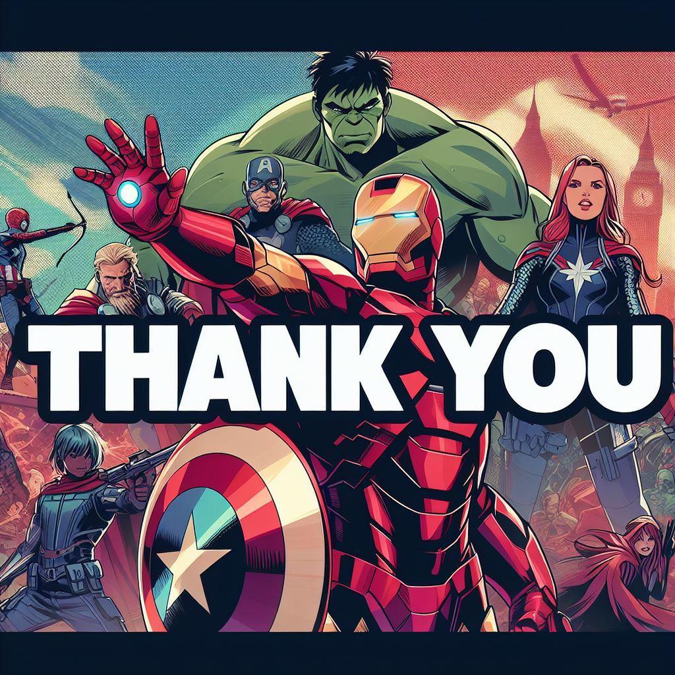
QUESTIONS?
*Template credits: prezentr.com
and Slidesgo

